Slide 1


Assessing the Association Between Accident Injury Severity and NCAP Car Safety Ratings
Ryan Jarrett
Lucy D’Agostino McGowan
Department of Biostatistics, Vanderbilt University
Notes:
Lucy
NCAP “New Car Assessment Program” from NHTSA – National Highway Traffic Safety Administration

Slide 2
Outline
Background
Methods
Data Sources
Variable Definitions
Model
Results
Conclusions
Notes:
Lucy

Slide 3
Outline
Background
Methods
Data Sources
Variable Definitions
Model
Results
Conclusions
Notes:
Lucy

Slide 4
Background
Purpose: to assess the relationship between cars' safety ratings, as reported by the NHTSA on a 5-star scale, and the maximum injury severity observed for individuals in these cars.
Notes:
Lucy

Slide 5
Background
Each year millions of new cars are sold in the US.
65% of new car consumers report that safety was their primary concern (Consumer National Reports Research Center, 2012)
Notes:
Lucy
Car safety remains the predominant consideration among shoppers for new cars

Slide 6
Background – Safety Ratings
National Highway Traffic Safety Administration
Notes:
Lucy

Slide 7
Background - Safety Ratings
Safety tests are conducted by the NHTSA on a subset of cars each year
Tests are conducted under highly controlled circumstances with test dummies in the driver and front passenger seats
frontal collision at 35 mph
side collision at 38.5 mph
Each car model tested subsequently receives (among others) an overall rating out of 5 stars.
Safety ratings are only comparable within weight class
Notes:
Lucy
*test dummies have censors, hit with a car of similar size, have male & female test dummies

Slide 8
Background
We are interested in evaluating how effective these ratings are in preventing passenger injury in real world crashes.
Notes:
Lucy
Trying to answer the question “given that someone is in an accident, what is the effect of an additional star rating on lowering his or her propensity to be injured?”

Slide 9
Outline
Background
Methods
Data sources
Weighting scheme
Variable definitions
Model
Results
Conclusions
Notes:
Ryan

Slide 10
Methods – Data Sources
National Automotive Sampling System (NASS) General Estimates System (GES) for the years 2011-2014.
Maximum injury severity
Accident condition variables (weather, point of impact, type of accident etc.)
Passenger-level variables (age, sex, alcohol, seat-belt use, etc.)
NHTSA 5-Star Safety Ratings from www.safercar.gov
Overall safety rating
Weight of the vehicle
Notes:
Ryan

Slide 11
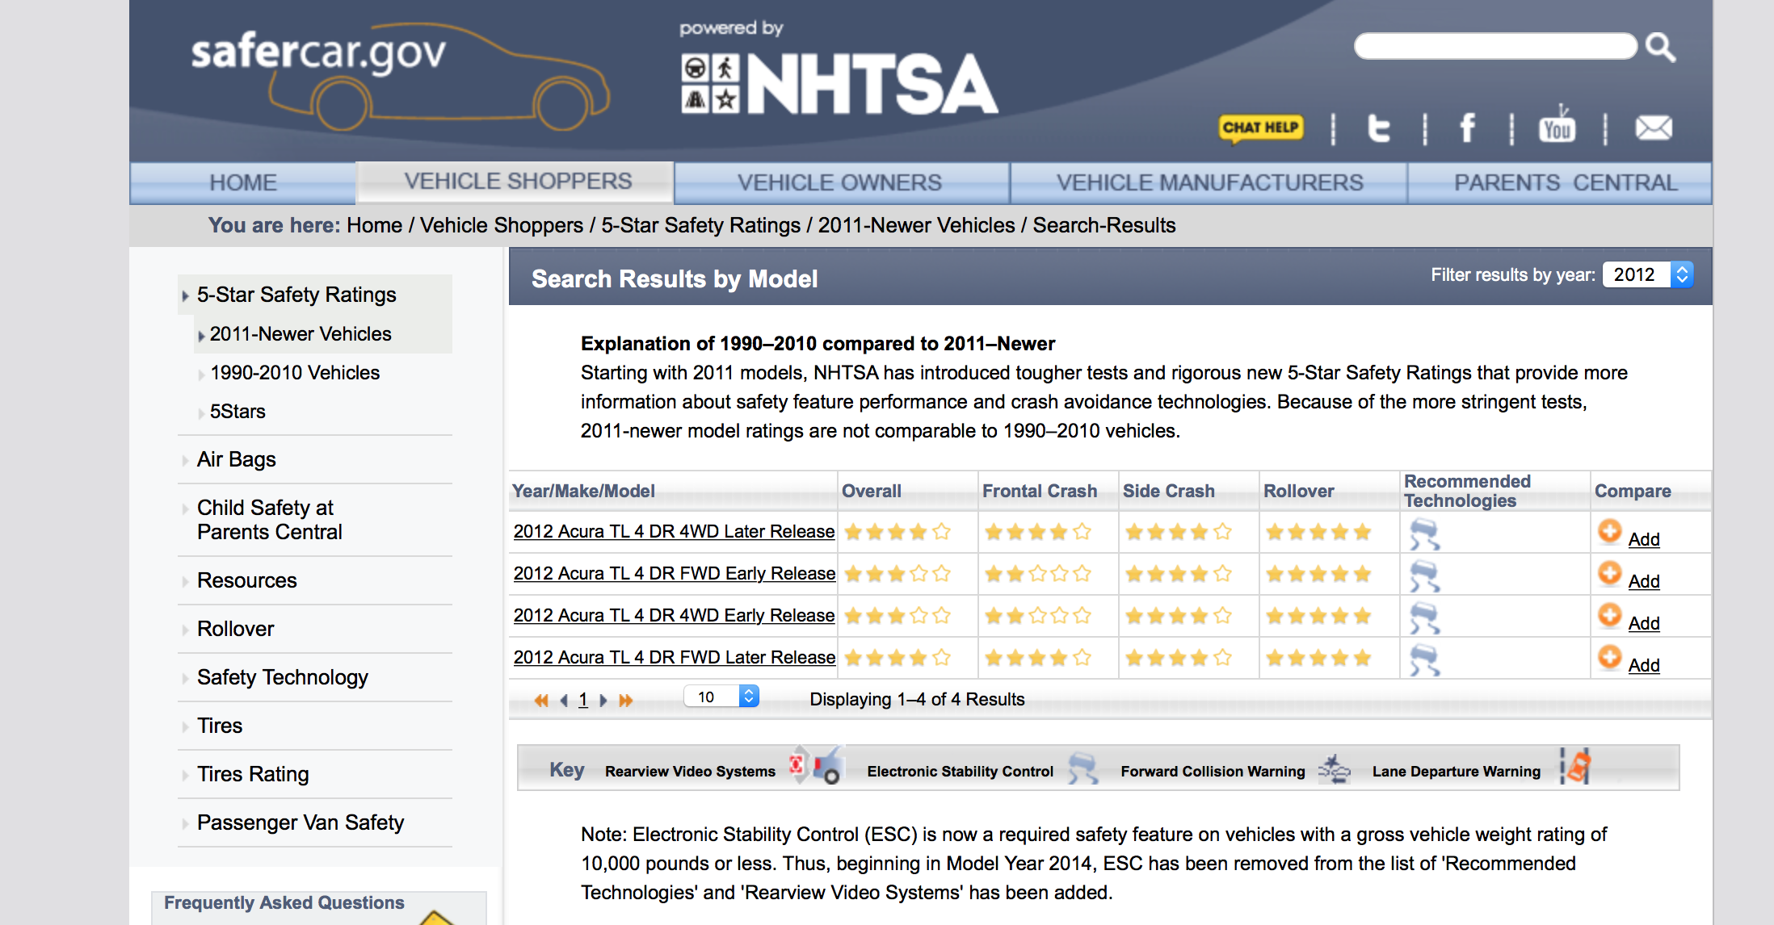
htmlTree2 <- readLines(url2, warn="F") weight.text <- htmlTree2[grep("Vehicle Test Weight", htmlTree2)] vehicle.weight <-sub(".*?Weight: (.*?) lbs.*", "\\1", weight.text) vehicle.weight <- as.integer(vehicle.weight) # get safety ratings star.text <- htmlTree[grep("class=\"stars b_right\"><img src=\"/staticfiles/scassets/images/", htmlTree)]
if(length(star.text)%%4 == 0 & post2010) {
red.star.text <- star.text[1:4]
red.star.text2 <- star.text[5:8]
overall.rating <- unique(as.numeric(unlist(strsplit(gsub("[^0-9]", "", unlist(red.star.text[1]))
}
Notes:
Ryan

Slide 12
Methods – Weighting Scheme
Nationally representative probability sample selected from all police-reported crashes.
Eligibility:
A Police Accident Report must be completed for the crash
Crash must involve at least one motor vehicle traveling on a trafficway
Crash must result in property damage, injury, or death
Notes:
Lucy
The National Automotive Sampling System (NASS) - General Estimates System (GES) data are obtained from a nationally representative probability sample selected from all police-reported crashes.

Slide 13
Methods – Weighting Scheme
Stage 1
NASS GES divides the U.S. into 1,195 primary sampling units (PSU)
A sample of police jurisdictions within each PSU
Stage 2
A subset of crashes are selected
Stage 3
Notes:
Lucy
The first stage is a sample of geographic areas, called Primary Sampling Units (PSUs), from across the United States. A PSU is a central city, a county surrounding a central city, an entire county, or a group of contiguous counties. The NASS GES divides the U.S. into 1,195 of these PSUs. The PSUs are then grouped into categories according to the following geographic regions and types of PSUs:
The second stage of the design is a sample of police jurisdictions within each PSU. In most PSUs the number of police jurisdictions is more than can reasonably be visited by a data collector, so in most PSUs the police jurisdictions are sampled based upon probability proportional to the number of crashes investigated in the police jurisdiction. That is, as the number of crashes investigated increases, the probability of selecting that jurisdiction increases. An average of seven police jurisdictions have been selected within each PSU.
The third and final stage is the selection of crashes within the sampled police jurisdictions.

Slide 14
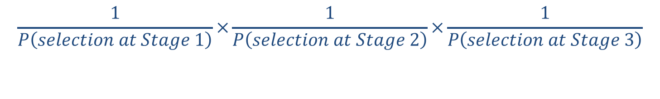
Methods – Weighting Scheme
Weight
=
$$\frac{1}{P\left(selection at Stage 1\right)}×\frac{1}{P\left(selection at Stage 2\right)}×\frac{1}{P\left(selection at Stage 3\right)}$$
Notes:
Lucy
this weight is the product of the inverse of the probabilities of selection at each of the three stages in the sampling process.

Slide 15
Methods – Design
Incorporating the design in the statistical analysis is vital
In order to obtain the correct standard error estimates for a subpopulation, we need to properly account for the weights and design
Notes:
Lucy

Slide 16
Methods – Design
All analysis was completed using R
We primarily utilized the survey package:
T. Lumley (2014) "survey: analysis of complex survey samples". R package version 3.30.
T. Lumley (2004) Analysis of complex survey samples. Journal of Statistical Software 9(1): 1-19
Notes:
Lucy
Thank you professor Lumley!

Slide 17
Methods – Variable Definitions
Outcome: Maximum Injury Severity within Vehicle
0: No injury
1: Possible injury
2: Non-incapacitating injury / Suspected minor injury
3: Incapacitating injury / Suspected serious injury
4: Fatal
Notes:
Ryan starts
- Ordinal effect

Slide 18
Methods – Variable Definitions
NHTSA Overall Rating
5 Stars: Injury risk for this vehicle is much less than average
4 Stars: Injury risk for this vehicle is less than average to average
3 Stars: Injury risk for this vehicle is average to greater than average
2 Stars: Injury risk for this vehicle is greater than average
1 Star: Injury risk for this vehicle is much greater than average
Notes:
Ryan
We didn't have any 1-star vehicles in our dataset

Slide 19
Methods – Variable Definitions
NHTSA Overall Rating
5 Stars: Injury risk for this vehicle is much less than average
4 Stars: Injury risk for this vehicle is less than average to average
3 Stars: Injury risk for this vehicle is average to greater than average
2 Stars: Injury risk for this vehicle is greater than average
1 Star: Injury risk for this vehicle is much greater than average
Notes:
Ryan
We didn't have any 1-star vehicles in our dataset

Slide 20
Methods – Variable Definitions
NHTSA Overall Rating
5 Stars: Injury risk for this vehicle is much less than average
4 Stars: Injury risk for this vehicle is less than average to average
2 or 3 Stars: Injury risk for this vehicle is average to greater than average or greater than average
Notes:
Ryan
We had very low counts for 2-star cars, so we combined with 3-starThe correct standard error estimate for a subpopulation that isnt a stratum is not just obtained by pretending that the subpopulation was a designed survey of its own.

Slide 21
Methods – Variable Definitions
Adjusted for:
Seat restraint misuse
Speeding
Indicator for interstate highway
Weather
Impact location
Alcohol involvement
Indicator for rollover
Indicator for airbag deployment
Manner of collision
Age
Sex
Age x Sex
Notes:
Ryan
*Imputation by sequential regression was instituted in 2010 using a software package called IVEware, developed at the University of Michigan.

Slide 22
Methods – Model
Examined proportional odds assumption for 5 class injury severity
Fit a logistic model:
Injured versus uninjured
Adjusted for all covariates shown previously
Fit an interaction between rating x weight class
Notes:
Ryan
Proportional odds assumption was violated ☹ more on this later

Slide 23
Outline
Background
Methods
Data sources
Weighting scheme
Variable definitions
Model
Results
Conclusions
Notes:
Lucy

Slide 24
Results
Weighted sample: N=2,595,190
Unweighted sample: N=19,428
Merged 4 years of data (2011-2014)
Included vehicles:
had a safety rating (2011+)
had passengers with known injury severity
Notes:
Lucy

Slide 25
Results
Maximum Injury Severity | Weighted frequency (%)
No injury | 2,170,141.59 (83.6%)
Possible Injury | 292,545.144(11.3%)
Non-incapacitating | 112,222.17 (4.3%)
Incapacitating | 17,993.48 (0.7%)
Fatal | 2,287.26 (0.08%)
Notes:
Lucy
The primary outcome of this analysis is the maximum injury severity of any person in the vehicle. Used imputed variable.

Slide 26
Results
NHTSA Safety Rating | Weighted frequency (%)
2 - or 3 - stars | 201,239.8 (8.1%)
4 - stars | 1,448,491.93 (55.8%)
5 - stars | 936,457.93 (36.1%)
Notes:
Lucy

Slide 27
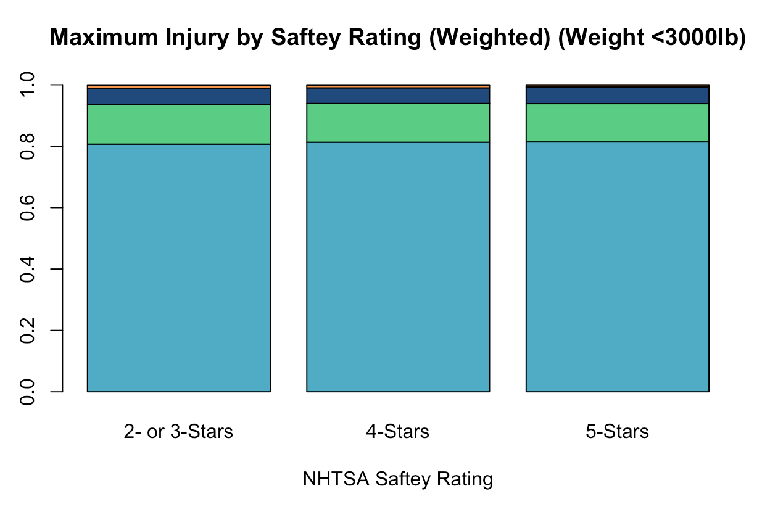
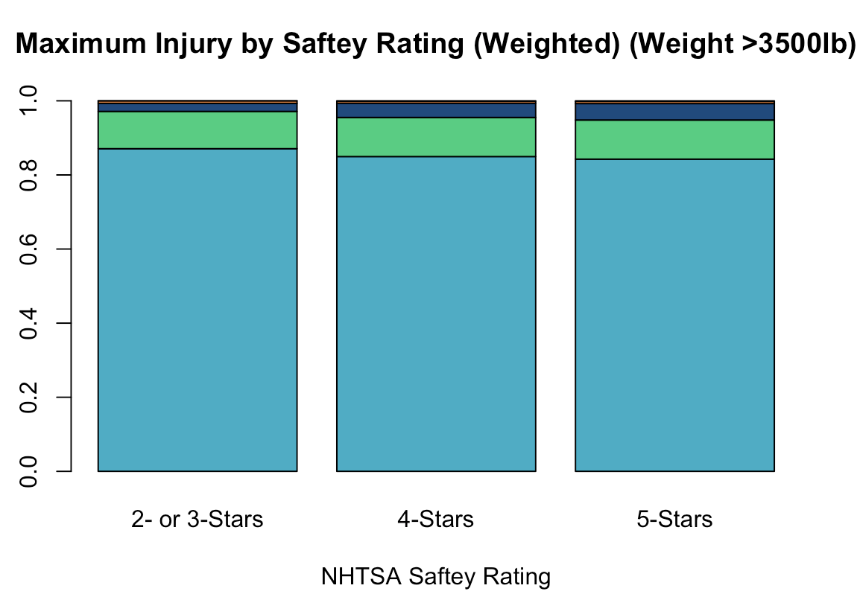
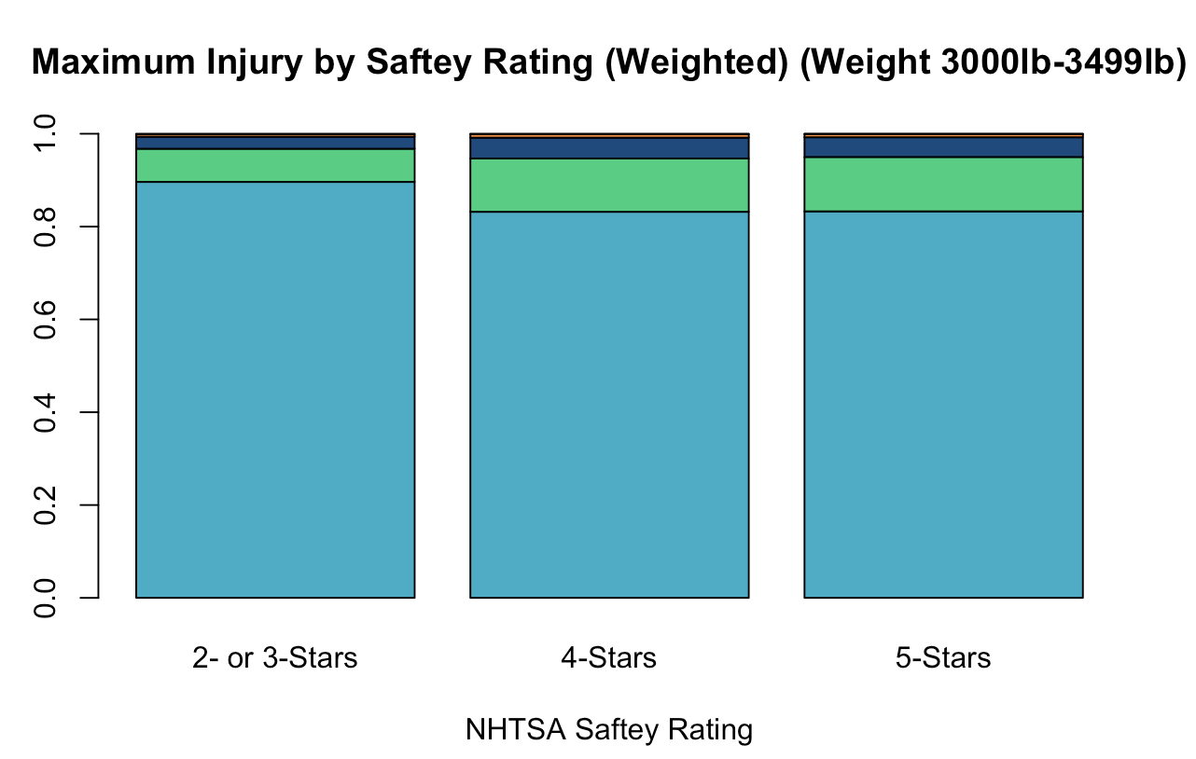
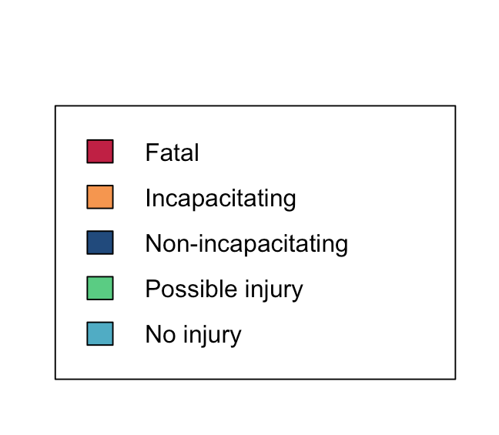
Results
Examined by weight class
Notes:
Lucy
Must look within weight class
Univariate data

Slide 28
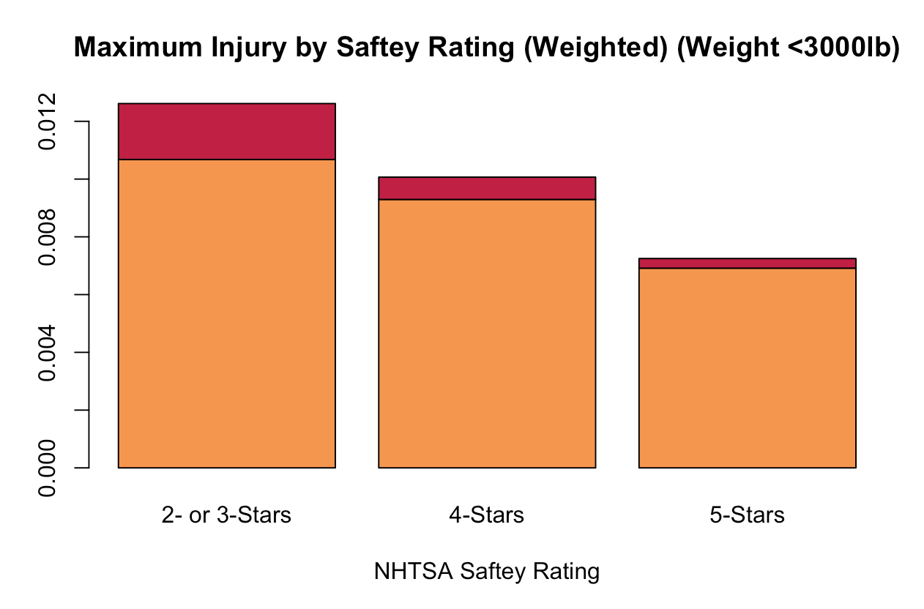
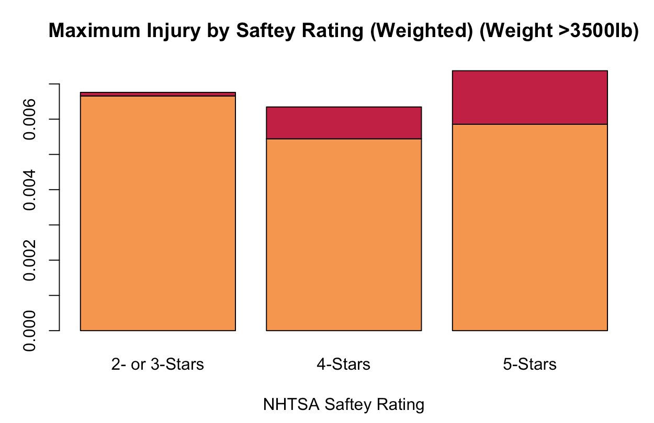
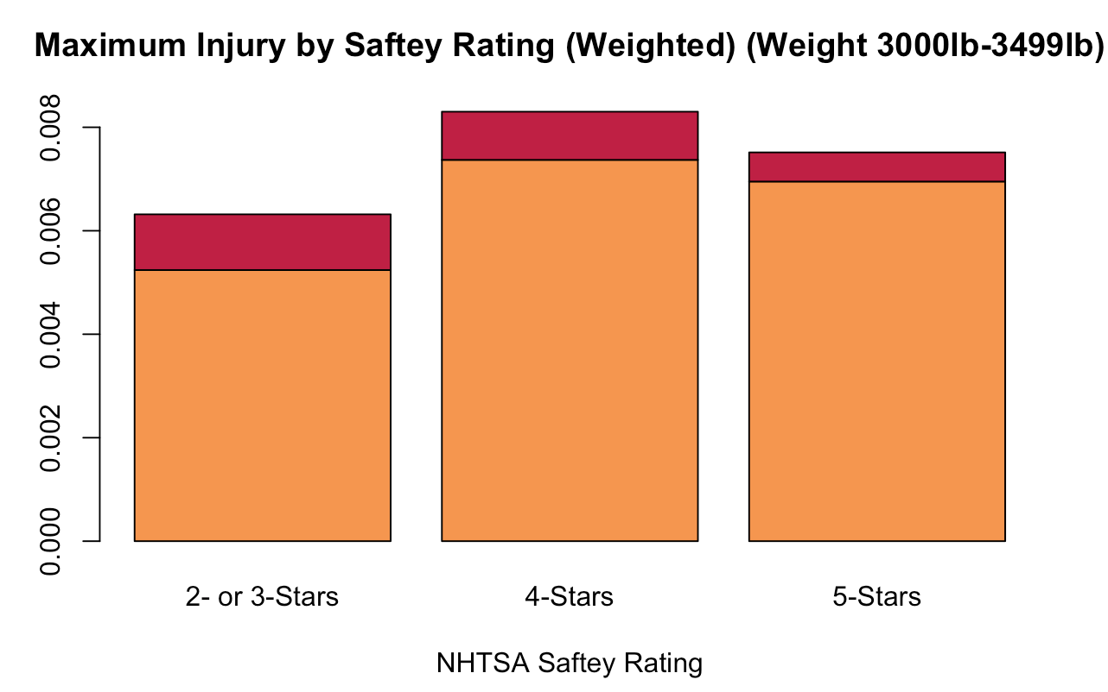
Results
1vehicle
Examined by weight class
Notes:
Lucy
This looks strange, however it represents so few data points when looking at the unweighted sample, for example
- Because some of these categories were so small, a multinomial model was not possible, therefore we fit a logistic regression injured vs not

Slide 29
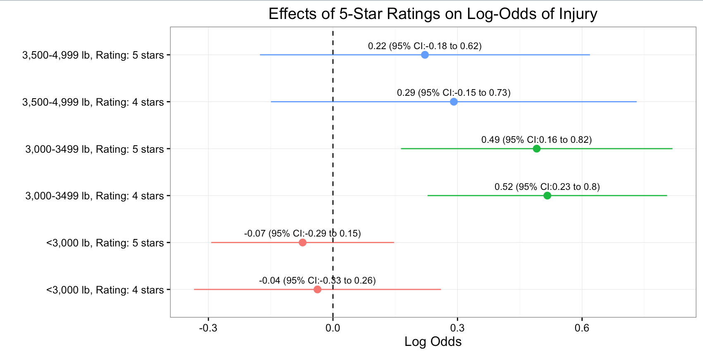
Results
Notes:
Lucy
Even after adjustment, still saw this result. We can’t find a reasonable explanation – perhaps there is a confounder we are missing.

Slide 30
10 Cars with greatest % injuries (3000-3499)
10 Cars with least % injuries (3000-3499)
Make/Model | Rating | Weighted freq of injury (%)
Mitsubishi Outlander | 4/5-stars | 794.2 (31.3%)
Mitsubishi Lancer | 4-stars | 893.0 (28.3%)
Kia Sportage | 4-stars | 2419.6 (26.6%)
Dodge Caliber | 3-stars | 1910.5 (26.6%)
Nissan Leaf | 4/5-stars | 398.6 (24.2%)
Nissan Juke | 4-stars | 1637.2 (23.8%)
Mazda6 | 4/5-stars | 2438.9 (20.7%)
Volkswagen Passat | 5-stars | 3154.0 (19.1%)
Nissan Altima | 4/5-stars | 16,733.3 (18.6%)
Chevrolet Cruze | 5-stars | 17,182.2 (17.7%)
Make/Model | Rating | Weighted freq of injury (%)
Audi A3 | 5-stars | 0 (0%)
Mercury Mariner | 3-stars | 52.0 (3.5%)
Ford Transit Connect | 2-stars | 330.2 (3.8%)
Hyundai Tucson | 4-stars | 336.5 (4.0%)
Chrysler 200 | 5-stars | 58.3 (5.3%)
Mazda Tribute | 3-stars | 79.7 (9.1%)
Jeep Compass | 3/4-stars | 477.4 (9.6%)
Ford Escape | 3/4-stars | 7203.0 (9.8%)
Toyota Scion tC | 4-stars | 361.9 (10.1%)
Subaru Forester | 4/5-stars | 2399.0 (13.4%)
Notes:
Lucy
1 2/3 star in top 10 injury, but 5 in bottom 5 injuries for this weight class
*interestingly, the Ford Transit Connect was updated to a 5-star overall rating in 2014 (our dataset only include 2012 & 2013 models)

Slide 31
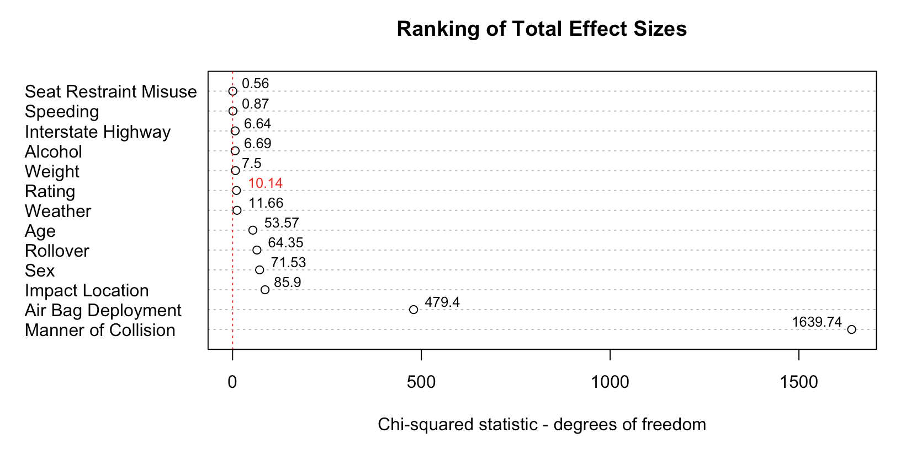
Results
Notes:
Lucy

Slide 32
Outline
Background
Methods
Data sources
Weighting scheme
Variable definitions
Model
Results
Conclusions
Notes:
Lucy

Slide 33
Limitations
This analysis was limited to vehicles that were in accidents – we don’t know the distribution of ratings in the general population
It is possible that 4 or 5 star cars are more likely to be rated than 2 or 3 star cars
Limiting ourselves to using ratings from 2011-2014 drastically decreased our sample size and limited the information about other cars involved in each accident
We were only able to observe 330 unique make/model/year combinations
Notes:
Lucy
*weight class difference in all cars in accident
*These results are strange…we’d love to see this replicated in an independent analysis.

Slide 34
Conclusions
We have some evidence to show that ratings contribute to whether or not passengers are injured, however this relationship is complex
The main predictor for whether the passenger is injured is the type of collision, followed by whether an airbag was deployed
This proved to be an awesome learning experience
Allowed us to integrate:
Advance coding techniques/website scraping
Complex survey analysis
Statistical Inference
Notes:
Ryan

Slide 35
Conclusions
Future research:
We would have liked to have fit a multinomial model, however the data limitations did not allow this
Perhaps as these ratings become more ubiquitous this relationship will become clearer
Notes:
Ryan

Slide 36
Contact Information
Ryan Jarrett
ryan.t.jarrett@vanderbilt.edu
Lucy D’Agostino McGowan
ld.mcgowan@vanderbilt.edu

Slide 37
Appendix
Also analyzed severe injury vs. not severe injury using logistic regression

Slide 38
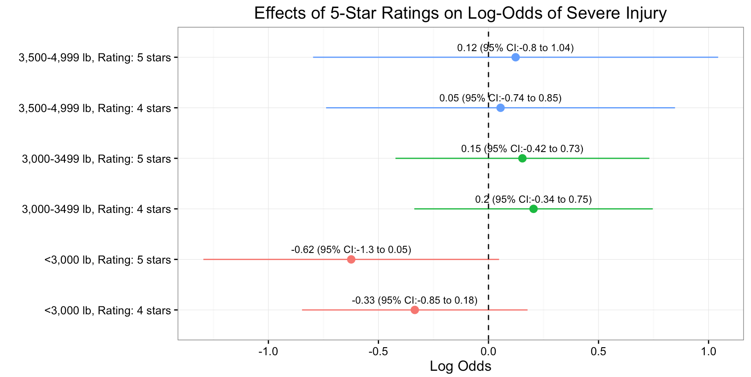
Results
Notes:
Null results…

Slide 39
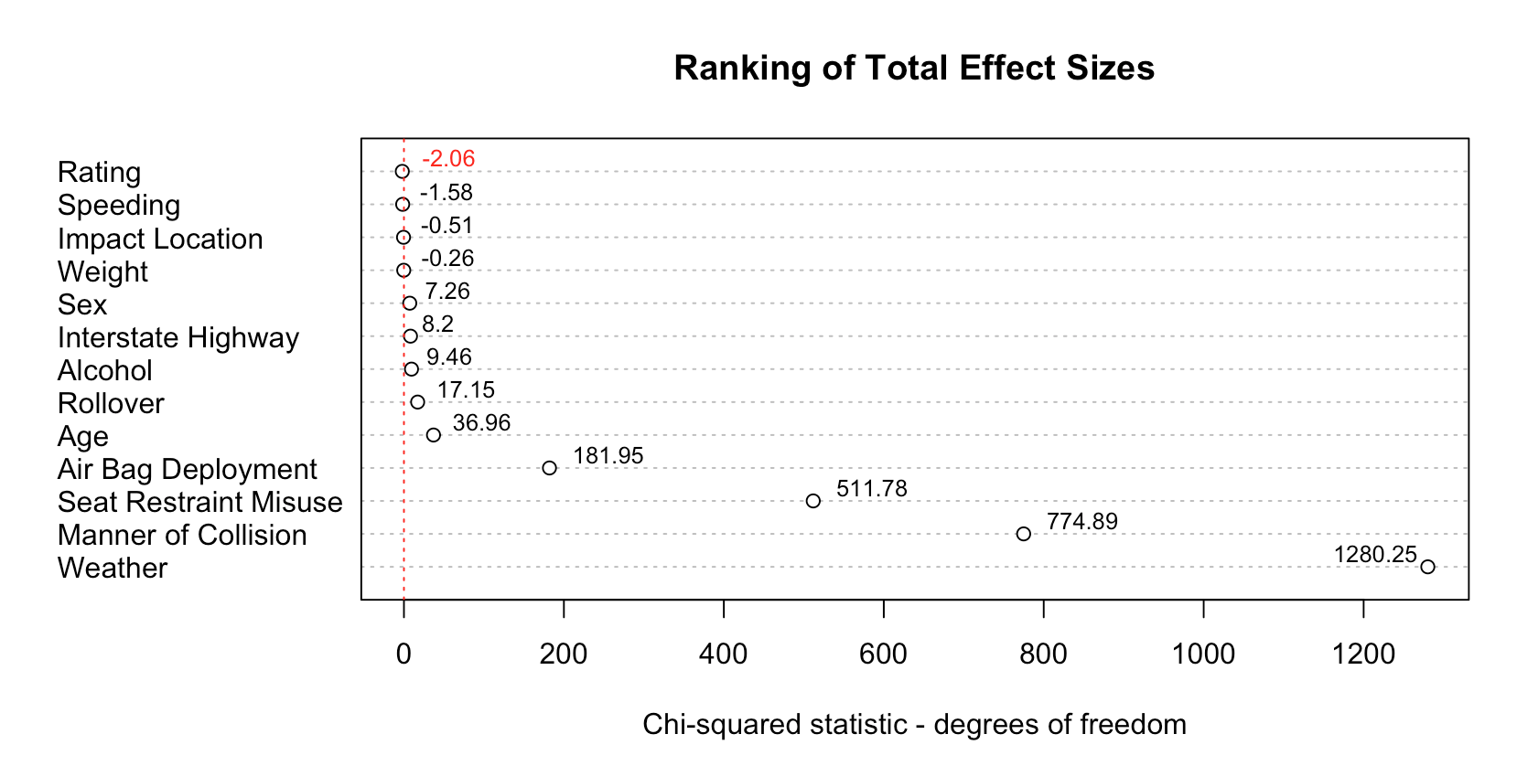
Results
Notes:
Null results…

